Slide 1
Industrial Cybersecurity Workforce Development Update
For ISAGCA
Sean McBride
21 June 2022

Slide 2
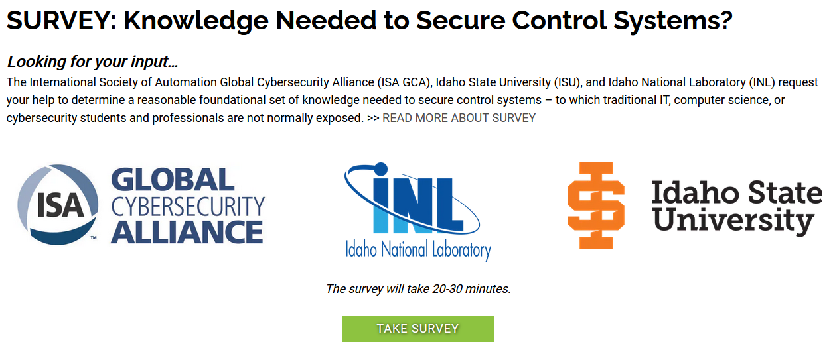
Survey - Knowledge
Up to 378 questions
Three sections
  Respondent Background
  ICS Knowledge
  Industrial
  Cybersecurity
  Knowledge
Dates:
  Opened Jan 2022
  Closed in Mar 2022

Slide 3
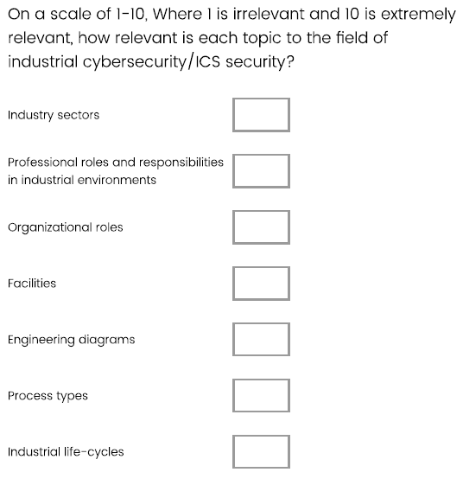
Approach
Respondents were given a strawman of 9 categories and 77 topics
For each:
  Rank relevance (scale 1-10)
  Choose: Keep as-is, Change, Remove
  Provide suggestion for “Change”
  Provide reasoning for “Remove”
  Add

Slide 4

Survey Responses
170 Respondents started the survey
122 finished Section I
71 finished Section II
65 finished Section III
~400 suggestions to change, remove, add
Notes:
17
6
14
9
13
55
-
117
2
3
3
4
5
3
3
14
-
37
5
5
1
3
3
4
3
3
2
6
4
2
1
18
-
60
4
4
3
6
4
6
6
5
-
38
~

Slide 5
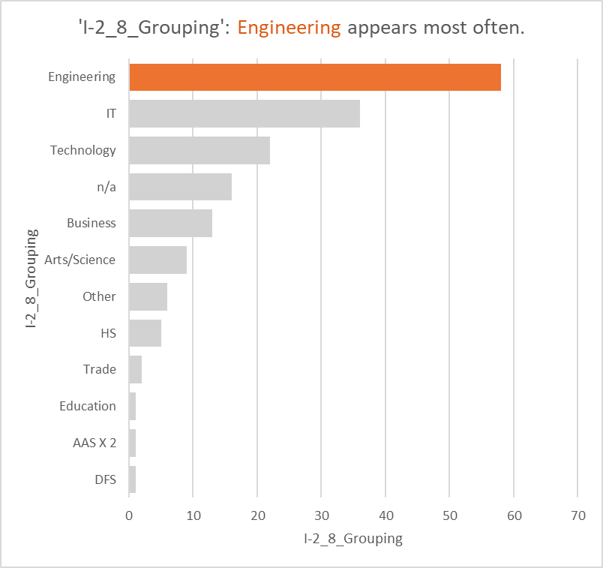
Section 1 Survey Summary
Question I-2/8 Major field of study of highest degree
Comments:
Text Free form were grouped into Majors
Engineering is prevalent
Total Count:170

Slide 6
Survey Results – Section II: ICS Knowledge
On a scale of 1-10, Where 1 is irrelevant and 10 is extremely relevant, how relevant is each category to the field of industrial cybersecurity/ICS security?
Grouped into three categories: 1-3 Not; 4-7 Moderately; 8-10 Very
 |  | Relevance
Category |  | Very | Moderately | Not | Total
Industrial Communications |  | 82 | 10 | 1 | 93
Safety |  | 79 | 12 | 2 | 93
Instrumentation and Control |  | 72 | 20 | 1 | 93
Industrial Operations Ecosystem |  | 63 | 31 | 0 | 94
Equipment Under Control |  | 61 | 26 | 5 | 92

Slide 7
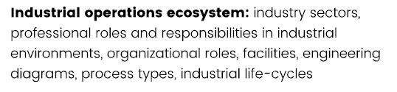
Category “Industrial Operations Ecosystem”
Suggestions for “change title”
Respondent ID | Response content
R_2YX5Hjj1Z8JitHY | Industrial Operations and the Enterprise: the risks
R_26hX0Es8WVUZ3i0 | Industrial Operations Administration
R_3esDNNOgJnH5tM1
R_3lMl6Hi3p0cr1K4 | Industrial Control Systems Environments
R_1rGFDHuFhnB2AQB | The definition is too broad. You have included people and engineering designs as synonamous. . Our profession and this subset of the automation profession want to play a game of very precise language but then wants large public acceptance. The two can't work together. I think this catagory needs to be split into the People (profession, organizations, certifications, etc) part and the products the people create (Designs, specifications, etc))

Slide 8
Relevance of topics within “Industrial Operations Ecosystem”
 | Relevance
Topic | High | Moderate | Low |  | Average rating
Industrial life-cycles | 64.6% | 31.6% | 3.8% |  | 7.97
Professional roles and responsibilities in industrial environments | 64.6% | 29.1% | 6.3% |  | 7.73
Engineering diagrams | 65.8% | 29.1% | 5.1% |  | 7.70
Process types | 59.5% | 36.7% | 3.8% |  | 7.67
Facilities | 49.4% | 46.8% | 3.8% |  | 7.34
Organizational roles | 49.4% | 44.3% | 6.3% |  | 7.24
Industry sectors | 51.9% | 38.0% | 10.1% |  | 7.03

Slide 9
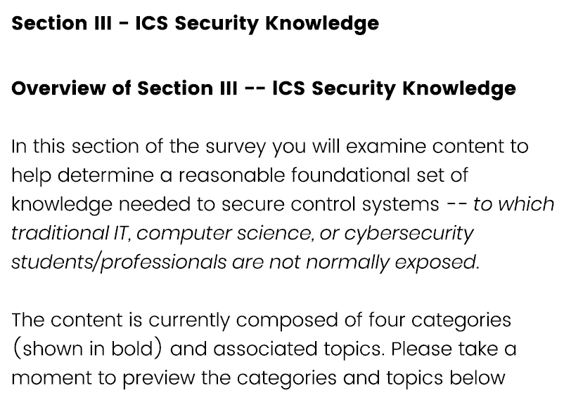
Survey Results – Section III: Industrial Cybersecurity Knowledge

Slide 10
Relevance of Categories
On a scale of 1-10, Where 1 is irrelevant and 10 is extremely relevant, How relevant is each category to the field of industrial cybersecurity/ICS security?

Slide 11
Relevance of topics in “Defensive Techniques and Approaches”
On a scale of 1-10, Where 1 is irrelevant and 10 is extremely relevant, how relevant is each topic to the field of industrial cybersecurity/ICS security?

Slide 12


Next steps
Review each suggestion on its own merits
  Committee discussion
  Vote with simple majority to carry
  Documentation of each decision
Deliverables
  Curricular guidance on “Knowledge”
  Academic paper on the effort
  Release analysis and decisions
  Release raw data

